Slide 1



Single-Cell Genomics:
Unlocking the Next Era of Immunology
HACKBIO SINGLE-CELL SEQUENCING INTERNSHIP STAGE 1
TEAM ASPARAGINE
@thehackbio.com

Slide 2
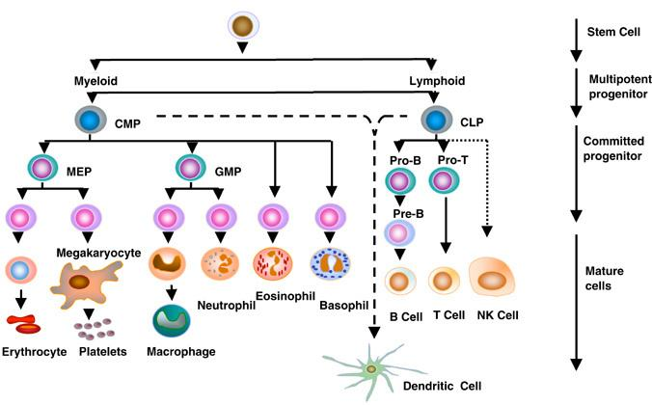
Introduction: The Immune System and Cell Diversity
The immune system is highly dynamic and plastic.
Forms a network connecting nearly every tissue in the body.
Understanding immune cell interactions is critical for therapeutic advances
Cellular functions are orchestrated by signaling between different types of cells.
https://periobasics.com/cellular-basis-of-immune-response/

Slide 3
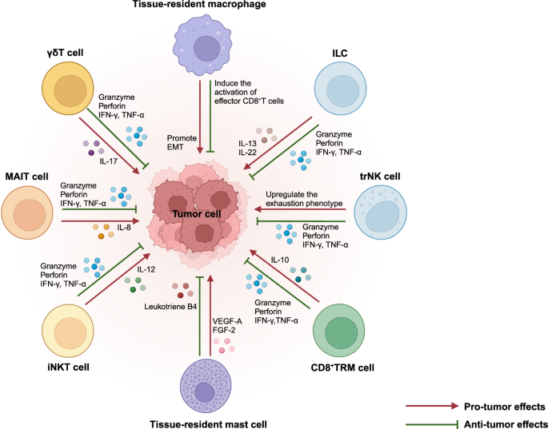
HOME
Limitations of Traditional Immune Cell Classification
Earlier belief: few molecular markers could define immune cell identity.
This has been disproven.
Immune cell identity depends on tissue environment and contextual cues.
Traditional methods overlook dynamic cell states and environmental influences.
Li, J., Xiao, C., Li, C. et al. Tissue-resident immune cells: from definin
g characteristics to roles in diseases. Sig Transduct Target Ther 10, 12 (2025).

Slide 4

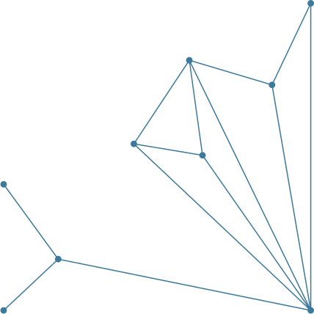
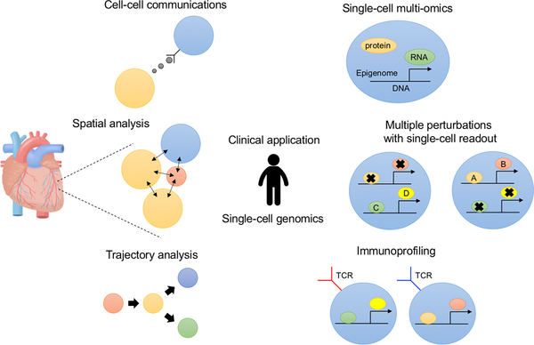
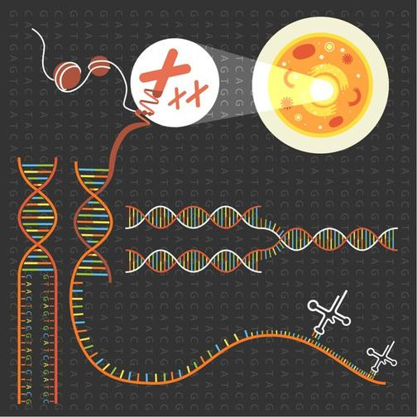
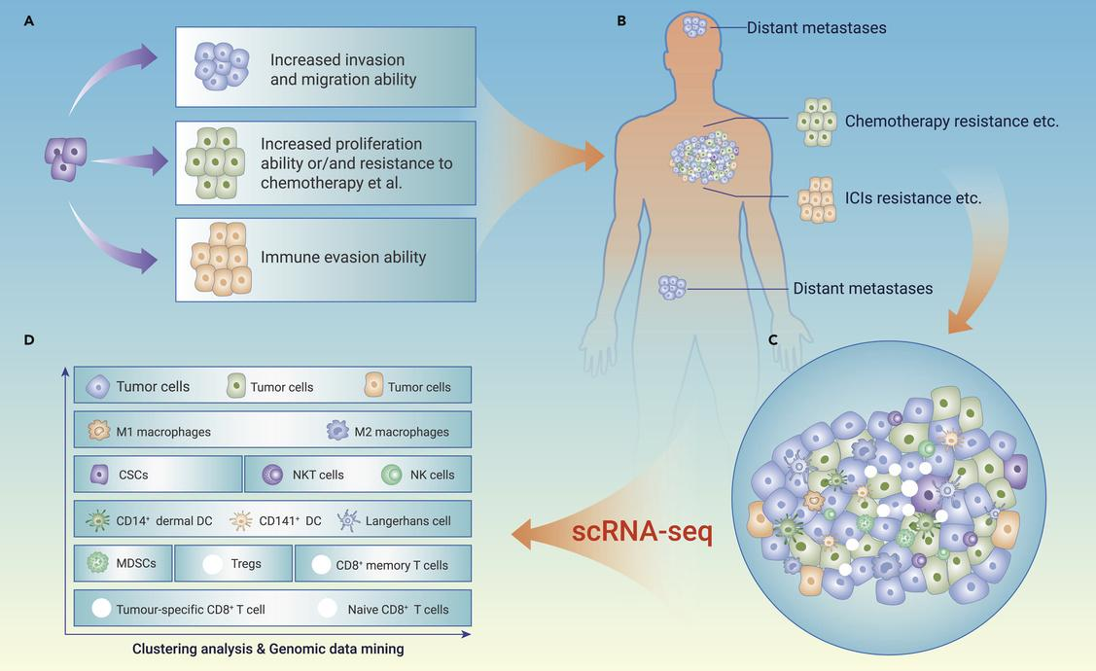
Rise of Single-Cell Genomics
It captures the full transcriptional diversity within complex tissues, identifying rare or transient cell populations that are often missed using traditional methods. This technology reveals dynamic functional states of immune cells, including activation, differentiation, and response to environmental cues.
Single-cell sequencing enables high-resolution characterization of individual cells, allowing researchers to distinguish subtle differences between cell types and functional states that would be masked in bulk experiments.
By analyzing cells individually, single-cell approaches overcome the averaging problem of bulk sequencing, which can obscure important cellular heterogeneity and rare populations.

Slide 5
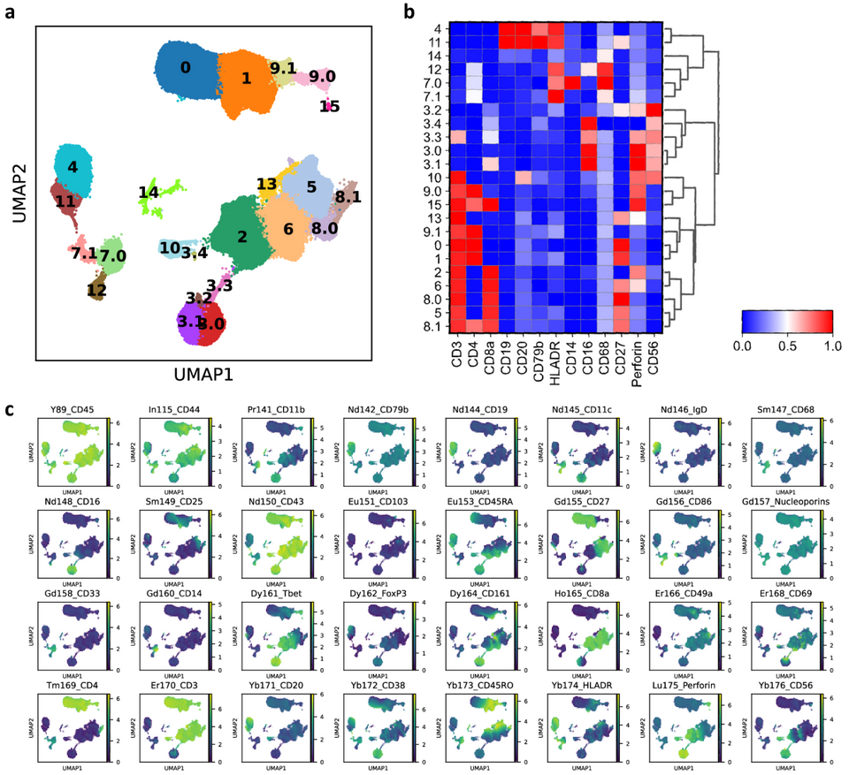
Multimodal Approaches and Their Advantages
Modern single-cell studies increasingly integrate multiple technologies to gain a more complete picture of immune cells and their context.
Flow cytometry and CyTOF provide detailed protein-level information for each cell, complementing transcriptional profiles from single-cell RNA-seq.
Lineage tracing techniques link transcriptional profiles to clonal history, revealing how cells differentiate and respond over time.
Together, these multimodal approaches reconnect the transcriptome with protein expression, spatial organization, and clonal lineage, providing a holistic understanding of immune system dynamics.
They also overcome dissociation bias inherent in standard scRNA-seq, ensuring that rare or sensitive cell types are not lost during sample preparation.

Slide 6
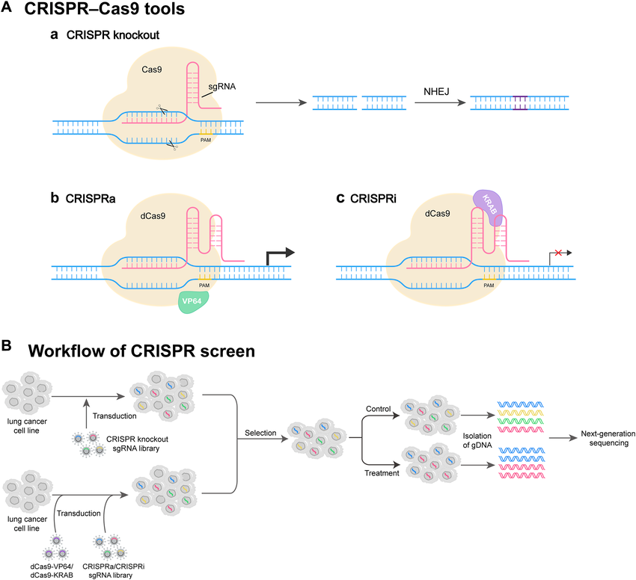

HOME
Challenges and Future Directions
Current challenges:
Huge datasets → analytical complexity
Hard to classify diverse cell types
Distinguishing subtle functional states
Removing technical noise
Conclusion:
Single-cell genomics is essential for decoding immune diversity and advancing precision therapeutics.
Emerging solutions:
Spatial methods
Lineage tracing
CRISPR perturbation
DOI:
10.3389/fcell.2023.1295555

